Slide 1

CORONAVIRUS / COVID-19
COVID-19
Coronavirus free presentation template

Slide 2
Instructions for use
Just being extra careful, you don’t really need them ;)
EDIT AS GOOGLE SLIDES
Make sure to be logged in your Google account.
Click the “Edit in Google Slides “ button below the template preview.
Get the editable template in your drive and start editing as Frank Sinatra or Fleetwood Mac would: in your own way.
EDIT AS A POWER POINT
Click the “Edit in Power Point” button below the template preview.
A .pptx file will be downloaded in your computer.
Open it as a Power Point and start rocking your presentation.
You are free to use this presentation under Creative Commons Attribution License. But please, either keep the Credits Slide or mention Slidecore and other used sources in the slide footer. Help to keep the free resources environment a better place :)

Slide 3

1
Introduction
Here you can write a small text about the topic.
2
Recommendations
Here you can write a small text about the recommendations to follow
INDEX
COVID - 19
3
Facts and Data
Here you can write a small text about situation reports

Slide 4
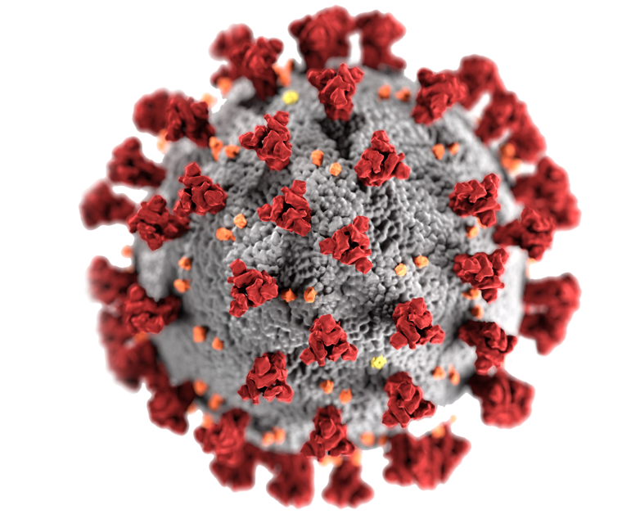
01
Introduction
Here you can write a small introduction about the topic.

Slide 5

What is a Coronavirus?
Coronaviruses are a large family of viruses which may cause illness in animals or humans. In humans, several coronaviruses are known to cause respiratory infections ranging from the common cold to more severe diseases such as Middle East Respiratory Syndrome (MERS) and Severe Acute Respiratory Syndrome (SARS). The most recently discovered coronavirus causes coronavirus disease COVID-19.

Slide 6

What is COVID-19 ?
?
COVID-19 is the infectious disease caused by the most recently discovered coronavirus. This new virus and disease were unknown before the outbreak began in Wuhan, China, in December 2019. COVID-19 is now a pandemic affecting many countries globally.
Source: World Health Organization

Slide 7
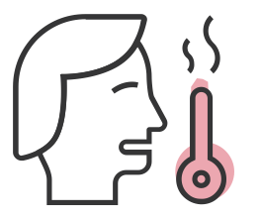

What are the symptoms of COVID-19?
Fever
Cough
Difficulty Breathing
Muscle Pain

Slide 8
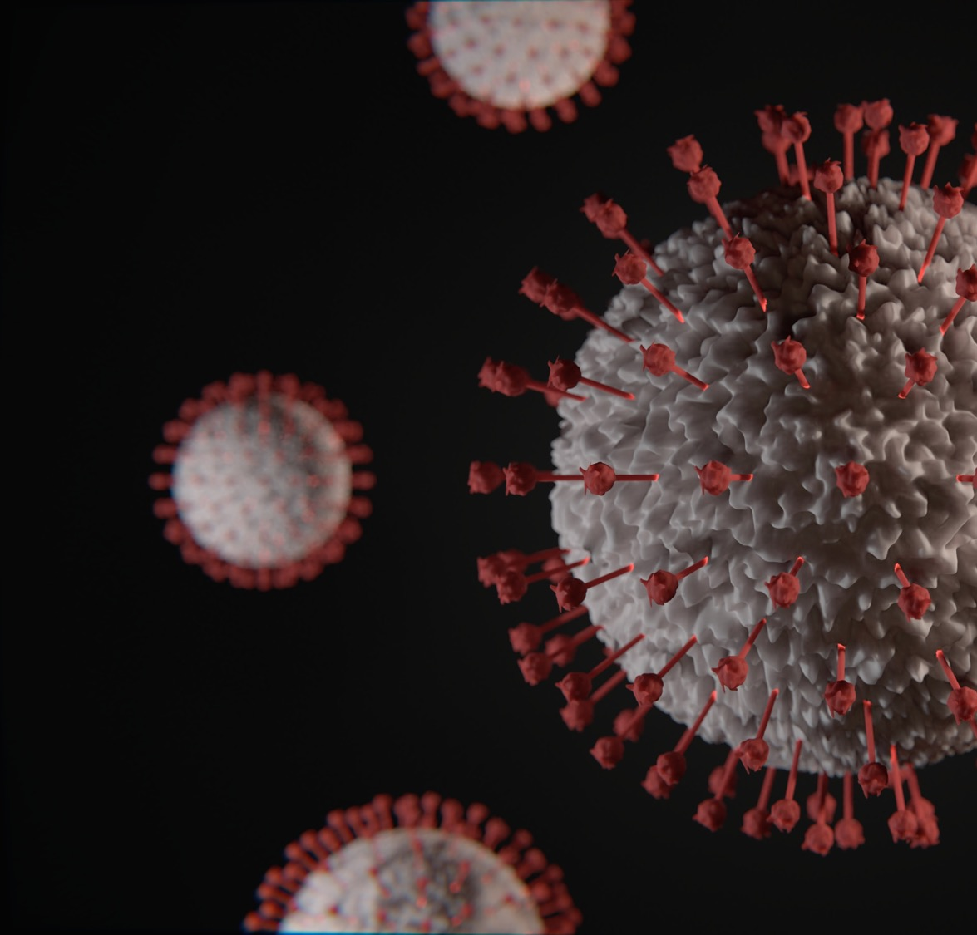



How does COVID-19 spread?
Person to person
Between people who are in close contact with one another.
Respiratory droplets
Through respiratory droplets produced when an infected person coughs, sneezes or talks.
Without symptoms
Some recent studies have suggested that COVID-19 may be spread by people who are not showing symptoms.

Slide 9
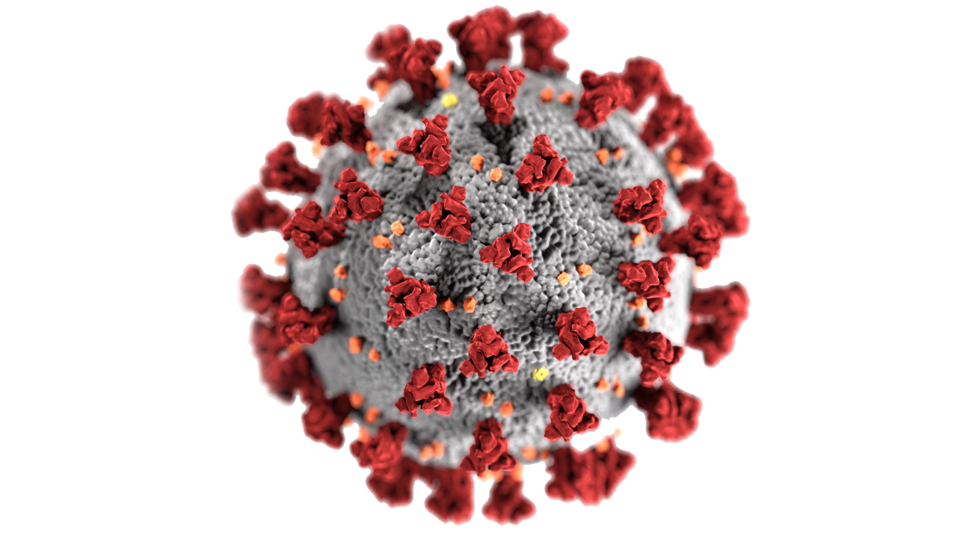
Some facts about the COVID-19
Common Symtoms
Recovery
Most common symptoms of COVID-19 are fever, dry cough, and tiredness.
Most people (about 80%) recover from the disease without needing hospital treatment.
Other Symtoms
1 out of every 5
Some patients may have aches and pains, nasal congestion, sore throat or diarrhea.
Around 1 out of every 5 people who gets COVID-19 becomes seriously ill and develops difficulty breathing.

Slide 10
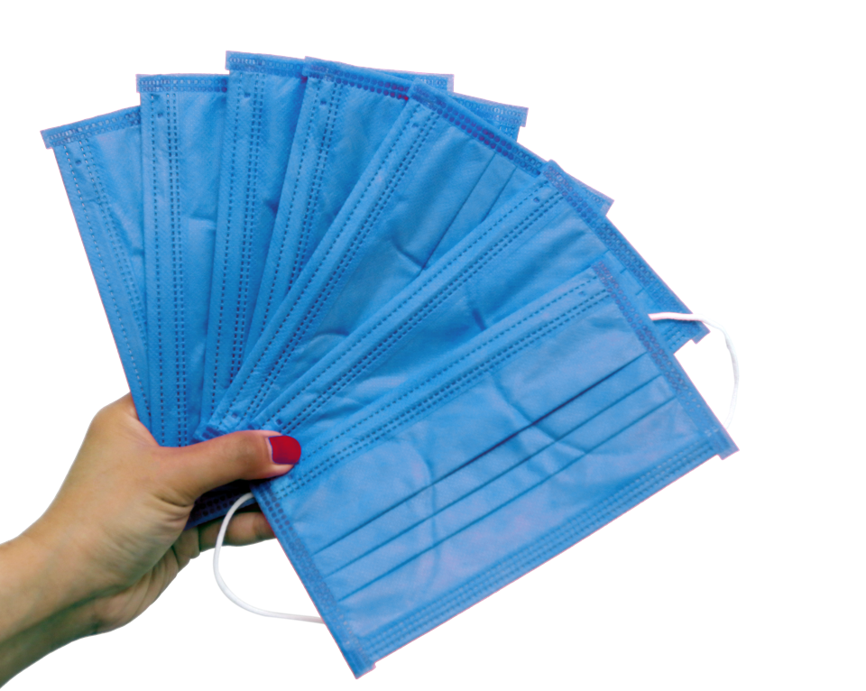
02
Recommendations
Here you can write a small introduction about the recommendations to follow

Slide 11

How can we protect others and ourselves if we don't know who is infected?
Stay aware of the latest information on the COVID-19 outbreak, available on the WHO website and through your national and local public health authority.
Most people who become infected experience mild illness and recover, but it can be more severe for others.

Slide 12


Keep Calm
And follow these recommendations
Wash your hands often
Wash your hands often with soap and water for at least 20 seconds especially after you have been in a public place
Avoid close contact
Put distance between yourself and other people. Remember that some people without symptoms may be able to spread virus.
Cover your mouth
These droplets can land on objects and surfaces around the person such as tables,

Slide 13




How can we protect others and ourselves if we don't know who is infected?
Hygiene
Social Distance
Practicing hand and respiratory hygiene is important at ALL times and is the best way to protect others and yourself.
When possible maintain at least a 1 metre (3 feet) distance between yourself and others.
Face masks
Disposable gloves
The use of face masks in public may serve as a means of source control to reduce the spread of the infection in the community.
Wearing a mask is unlikely to be of any benefit if you are not sick. If you do need to wear a mask, here is how to use one properly.

Slide 14
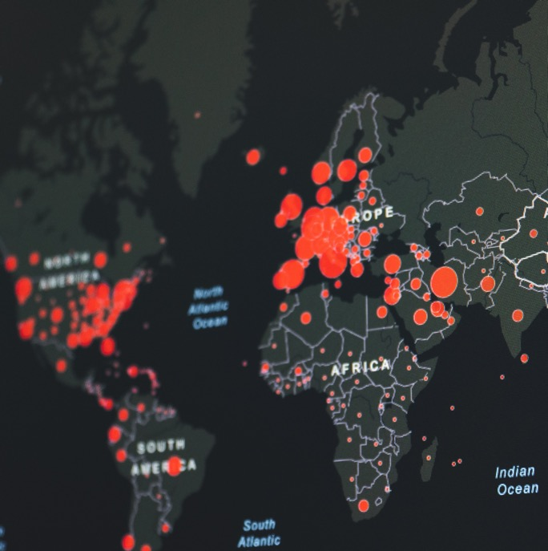
03
Situation Reports
Here you can write a small introduction about situation reports

Slide 15

Last update: 26 April 2020, 02:00 CEST
COVID-19
2.804.796
CONFIRMED CASES

Slide 16
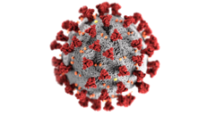
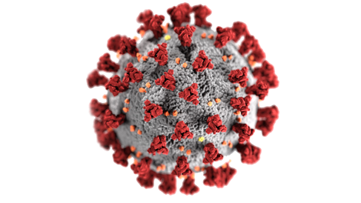


Last update: 26 April 2020, 02:00 CEST
(COVID-19)
Coronavirus disease
outbreak situation
CONFIRMED CASES
CONFIRMED DEATHS
COUNTRIES
2.804.796
193.722
213

Slide 17
COVID-19
Map vector
CONFIRMED CASES
2.804.796
CONFIRMED DEATHS
24545
COUNTRIES
454
NOTE: This is not an oficial map, no real dara are shown

Slide 18
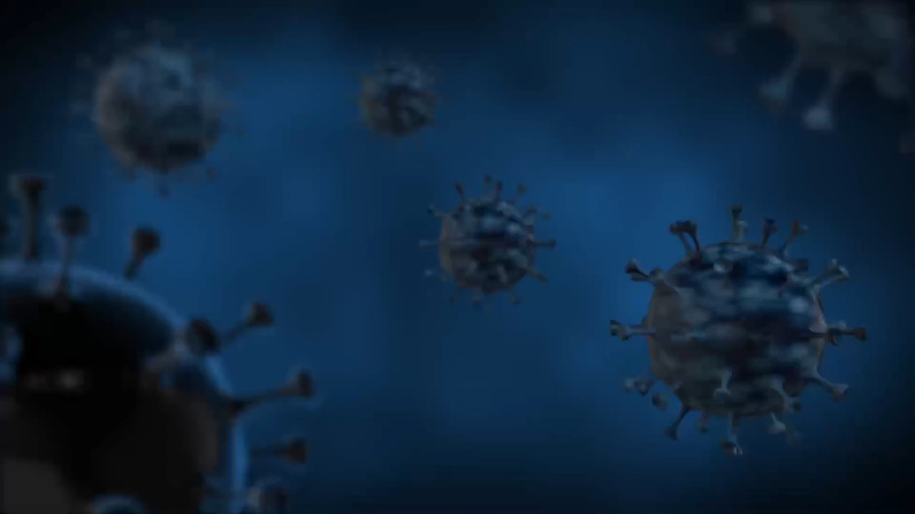
COVID-19
WOW
Video Loop Slide
Sed finibus vitae neque vel molestie. Phasellus luctus porttitor vulputate. Integer dictum ipsum vitae.

Slide 19
COVID-19
Break time
15 MIN

Slide 20
END
Thank you
PRESENTATION

Slide 21
Coronavirus icon pack
Icons by Copymouse

Slide 22

















Coronavirus icon pack 2
Icons by IconPai

Slide 23
Editable general Icon Set
Things you can do:
Resize the icon
Change fill color and opacity
Add stroke
Add dash lines

Slide 24

This template was made specially for you by
Big shout-out to the great people that provided us with the free resources of this presentation:
STOCK IMAGES
unsplash.com
pixabay.com
ICONS
Covi-19 icon pack
Copymouse
IconPai
Thick Icons
Nice and Serious
Visit slidecoretemplates.com to get more editable premium presentations for free

